Slide 1

Big data characteristics

Slide 2
Big data has turned into a hot cake for many associations and can be more useful for the enterprises like banking, internet business, insurance and manufacturing, and so forth to encourage their customers. Generally, at the point when the data was low in volume, it was effortlessly overseen and processed by traditional technologies. These technologies are unequipped for dealing with it as big data differs in terms of volume, velocity, and value as compared to the other data.
Big data is growing day by day because data is created by everyone and for everything from mobile devices, call centers, web servers, and social networking sites. But the challenge is that it is too large, too fast, and hard to handle for traditional databases and existing technologies. Many organizations gather massive amounts of data generated from high-volume transactions like call centers, sensors, weblogs, and digital images. The success of their business depends on meeting big data challenges while continually improving operational efficiency.

Slide 3
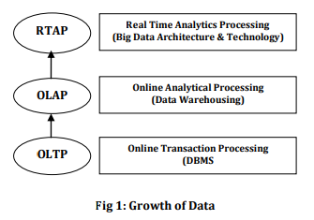
Big data is continuous including more & more data sets with high volume beyond the capability of regularly used software tools to capture, curate, handle and process data sets within a tolerable elapsed time.
A huge amount of data sets is created every second from every part of the world i.e. the volume of data can never be reduced but increases day by day.
Nearly five years ago, personal computer storage was tens to hundreds of gigabytes. IDC's Digital Universe Study predicts that between 2009 and 2020 digital information data will grow by 44% from 0.8 ZB to 35 ZB. Many surveys expect that volume of data will grow by 45% in the next two years, and few said it will be doubled. Thus, big data is a moving target and requires more attention to capture it, curate it, handle it and process it. Fig. 1 shows the exponential growth of big data volume with time.

Slide 4
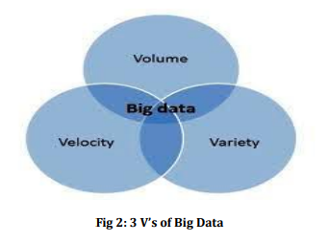
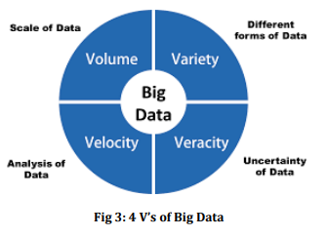
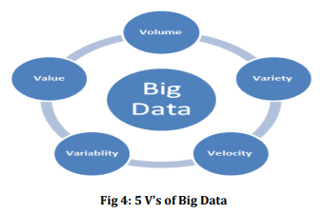
EVOLUTION OF 14 V’s AND 1C OF BIG DATA CHARACTERISTICS

Slide 5
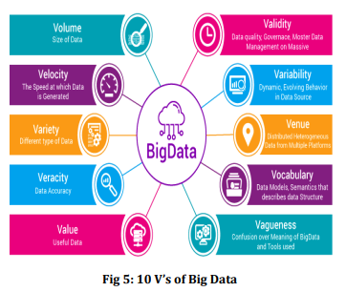

Slide 6
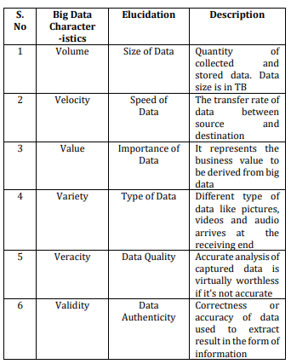
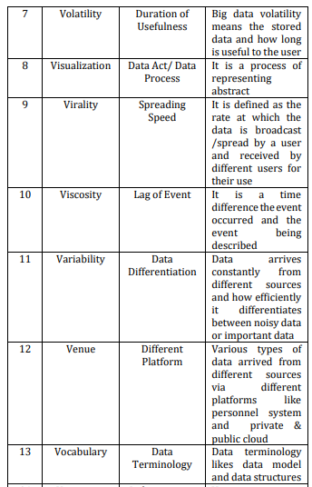
14 V’s of Big Data

Slide 7
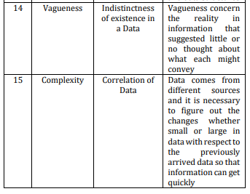
NEED FOR MORE EXPLORATION OF BIG DATA
1. If data was less and can be easily handled by RDBMS but nowadays it is not possible through RDMS tools, to manage big data. Because big data is different from other data in terms of five characteristics like Volume, Variety, Velocity, Variability, and Value.
2. Big data is in the form of Structured, un-structured, massive homogenous and heterogeneous. Therefore it is required to use a better and modified model to handle and transfer of big data over the network

Slide 8
The capability of taking out useful information from large data sets due to its characteristics like volume, variability, and velocity. It was not possible to do it before. So, exploration of big data in terms of volume, velocity, variety, variability, velocity, variety, value, virality, volatility, visualization, viscosity, and validity.
NEW 3 V’s OF BIG DATA CHARACTERISTICS
The 3 V’s of Big Data characteristics are defined as:
A. Verbosity Big data is massive data that comes from different sources which may be structured or unstructured data, good/bad data. Bad data refers to information that is wrong, out of date, or incomplete. The consequences of storing these types of information may be dangerous sometimes. So, it is recommended to check that the stored data is secured, relevant, complete, and trustworthy. If a suitable technique at the initial stage is applied to decide whether the information is useful or not, then storage space, as well as processing time can be saved. Keeping in mind the verbose nature of big data, ‘verbosity’ is one of the characteristics of big data which is defined as “The redundancy of the information available at different sources.”

Slide 9
B. Voluntariness
Big data is a set of huge amounts of data that can be used as a volunteer by different organizations without any interference. Big data voluntarily help numerous enterprises. It assists:
retailers by giving them knowledge of customer preferences, urban planning by visualization of the environment modeling and traffic patterns, manufacturers by predicting product issues to optimize their productivity and to improve the equipment and customers’ performance,
energy companies to meet energy demands during peak time and consequently, increase productivity and improve efficiency by reducing losses,
healthcare professionals to prevent diseases and improve patient health, research organizations to obtain the quality of research and revolutionize life science, physical science, medical science, and scientific research
financial service organizations to identify and prevent fraud, and government agencies to improve services in their respective fields.
Keeping in mind the voluntary behavior of the big data, ‘voluntary’ has been defined as one of the characteristics of big data which is defined as “The will full availability of big data to be used according to the context.”

Slide 10
C. Versatility
Big data is evolving to satisfy the needs of many organizations, researchers, and Governments. It facilitates urban planning, environment modeling, visualization, analysis, quality classification, securing environment, computational analysis, biological understanding, designing and manufacturing process required by organizations, and cost-effective models as well as elegant exploration of the result.
Keeping in mind the resourceful/adaptable nature of big data, we have identified ‘versatility’ as one of the characteristics of big data which is defined as “The ability of big data to be flexible enough to be used differently for a different context.”

